Slide 1

ANALYTICS I PRESENTATION
Benedict Leong Wei Xin
Presented by:
Benedict Leong Wei Xin (U1923641A)
Ho Wei Ling Charmaine (U1911802F)
Lim Shi Min (U2010855H)
Tan Kiang Hwee Jeremy (U2021940D)
Group 7

Slide 2
Benedict Leong Wei Xin
TABLE OF CONTENTS
INTRODUCTION
01
04
LINEAR REGRESSION
02
05
CART MODEL
BUSINESS OPPORTUNITY
PROPOSED APPROACH
03
06
RECOMMENDATION

Slide 3

Benedict Leong Wei Xin
INTRODUCTION

Slide 4



Benedict Leong Wei Xin
EIU ‘S CURRENT METHODOLOGIES
Traditional
In-house EIU expert ratings
Surveys
Panel expert inputs
INTRODUCTION
INTRODUCTION
BUSINESS OPPORTUNITY
ISSUE 1
PROPOSED APPROACH
ISSUE 2
LINEAR REGRESSION
CART MODEL
RECOMMENDATION
Notes:
EIU relies on traditional forecasting methodologies such as surveys, panel expert inputs and in-house EIU expert ratings.

Slide 5




Benedict Leong Wei Xin
EIU ‘S COMPETITORS
INTRODUCTION
INTRODUCTION
BUSINESS OPPORTUNITY
ISSUE 1
PROPOSED APPROACH
ISSUE 2
LINEAR REGRESSION
CART MODEL
RECOMMENDATION
Notes:
In the forecasting and advisory market, EIU is up against severe competition. In this sector, there are various significant industry players such as Oxford Economics, Forrester Research, CEIC Data and Stat Diagnostics that can erode EIU's market share. In order for EIU to maintain its position, EIU must deliver the best forecasting services available on the market. EIU should thus constantly improve its forecasting technique by embracing new technologies such as Machine Learning.

Slide 6

Benedict Leong Wei Xin
Machine learning is the application of artificial intelligence (AI) and computer science which provides systems the ability to learn automatically and improve from experience through the use of data and algorithms, instead of programming it explicitly.
WHAT IS MACHINE LEARNING?
INTRODUCTION
INTRODUCTION
BUSINESS OPPORTUNITY
ISSUE 1
PROPOSED APPROACH
ISSUE 2
LINEAR REGRESSION
CART MODEL
RECOMMENDATION
Notes:
Machine learning is the application of artificial intelligence (AI) and computer science which provides systems the ability to learn automatically and improve from experience through the use of data and algorithms, instead of programming it explicitly. This allows systems to imitate the way that humans learn and gradually improve its accuracy.

Slide 7



Benedict Leong Wei Xin
ADVANTAGES OF MACHINE LEARNING
Identify patterns
Higher accuracy
Higher performance
INTRODUCTION
INTRODUCTION
BUSINESS OPPORTUNITY
ISSUE 1
PROPOSED APPROACH
ISSUE 2
LINEAR REGRESSION
CART MODEL
RECOMMENDATION
Notes:
There are many advantages to using machine learning to make forecasts. To list a few, machine learning forecasting is able to identify patterns in data using past and historical data which would otherwise be hard to identify using traditional methods. Machine learning forecast is also especially helpful in cases where there are massive amounts of data. By training and testing the machine learning model, it is able to apply what it has learnt to a new set of data, hence being able to produce forecasts with higher accuracy and performance rates.

Slide 8

Benedict Leong Wei Xin
EXAMPLE OF MACHINE LEARNING
Vodafone worked with Datatonic to build traffic forecasting machine learning models to forecast the internet traffic on a network of 1000 location points
Forecast used to suggest when the network resources should be upscaled or downscaled
INTRODUCTION
INTRODUCTION
BUSINESS OPPORTUNITY
ISSUE 1
PROPOSED APPROACH
ISSUE 2
LINEAR REGRESSION
CART MODEL
RECOMMENDATION
Notes:
Vodafone Group is a British multinational telecommunications company that predominantly operates services in Asia, Africa, Europe, and Oceania. 5G technology is a game-changer for the telecommunications industry. As a step of moving towards an AI-powered 5G network, Vodafone worked with Datatonic to build traffic forecasting machine learning models. This allows Vodafone to forecast the internet traffic on a network of 10000 location points. The forecast of the model is used to suggest when the network resources should be upscaled or downscaled, in order to ensure that their customers have access to their services without lags or delays, and at the same time, avoid wasting operational resources by providing more network capacity than what is needed. Hence, this machine learning forecasting methodology helps Vodafone to use AI to enable optimal provisioning of resources on the network at a large scale and thus minimise the operation costs and energy consumption for a complex network. This example serves to show that machine learning is a tool which EIU could likewise leverage on to increase their forecasting accuracy.

Slide 9

Benedict Leong Wei Xin
BUSINESS
OPPORTUNITY

Slide 10


Benedict Leong Wei Xin
BUSINESS PROBLEM
Traditional demographic census
Some countries may not provide accurate data
Data is updated every few years or even in decades
Non-profit organisations have limited resources to distribute
INTRODUCTION
INTRODUCTION
BUSINESS OPPORTUNITY
ISSUE 1
PROPOSED APPROACH
ISSUE 2
LINEAR REGRESSION
CART MODEL
RECOMMENDATION
Notes:
In this regard, non-profit organisations face a lot of difficulty determining which countries to offer assistance to as there is an overwhelming number of factors to consider.
Currently, these non-profit organisations rely on traditional demographic census - which is typically not very reliable given that 1. some countries may not provide accurate data and 2. data is updated every few years or even in decades.
With the advent of Covid-19, this problem is more pressing than ever - there is a huge emphasis and importance placed on these data as there is a need to allocate medical supplies such as vaccines, testing kits and medication to countries with limited access to these resources, in a timely manner.

Slide 11




Benedict Leong Wei Xin
OPPORTUNITY FOR EIU
EIU can tap into this new market by providing a ranking of countries based on their health environment
INTRODUCTION
INTRODUCTION
BUSINESS OPPORTUNITY
ISSUE 1
PROPOSED APPROACH
ISSUE 2
LINEAR REGRESSION
CART MODEL
RECOMMENDATION
Notes:
We believe that EIU can tap into this new market by providing a ranking of countries based on their health environments. By providing this data, EIU will be able to fill the current market gap and non-profit organisations can rely on EIU’s data to make more informed and reliable decisions with regards to their humanitarian plans.
By expanding the scope of the reports they provide from their current business-centric reports to one that includes healthcare considerations, this would open up a new target market for EIU to tap into and expand their clientele. Additionally, EIU would be able to profit from a new revenue source and this would give EIU a competitive edge over their competitors.

Slide 12

Benedict Leong Wei Xin
PROPOSED APPROACH

Slide 13


Benedict Leong Wei Xin
Health Information Resource Allocation (H.I.R.A) Score
Machine Learning
INTRODUCTION
BUSINESS OPPORTUNITY
PROPOSED APPROACH
ISSUE 2
LINEAR REGRESSION
CART MODEL
RECOMMENDATION
Notes:
We propose to use machine learning to derive a score that is reflective of a country’s healthcare environment.

Slide 14

Benedict Leong Wei Xin
INDICATORS
Annual GDP Growth
Annual PM2.5 Exposure
DPT Immunisation and
Measles Immunisation
Gini Coefficient
Neonatal Mortality Rate
Gender Gap
Population Living in Slums
Prevalence of Undernourishment
Cause of death, by communicable diseases and maternal, prenatal and nutrition conditions
Political Stability
INTRODUCTION
BUSINESS OPPORTUNITY
PROPOSED APPROACH
ISSUE 2
LINEAR REGRESSION
CART MODEL
RECOMMENDATION
Notes:
After performing some preliminary research, we have identified the following factors that we believe are indicative of the H.I.R.A score.

Slide 15


Benedict Leong Wei Xin
MACHINE LEARNING MODELS
Linear Regression
Classification and Regression Trees (CART)
INTRODUCTION
BUSINESS OPPORTUNITY
PROPOSED APPROACH
ISSUE 2
LINEAR REGRESSION
CART MODEL
RECOMMENDATION
Notes:
We identify 2 potential machine learning models we could adopt, namely:
Linear Regression
CART
Before we can start working on the machine learning models, we need to perform data cleaning.

Slide 16
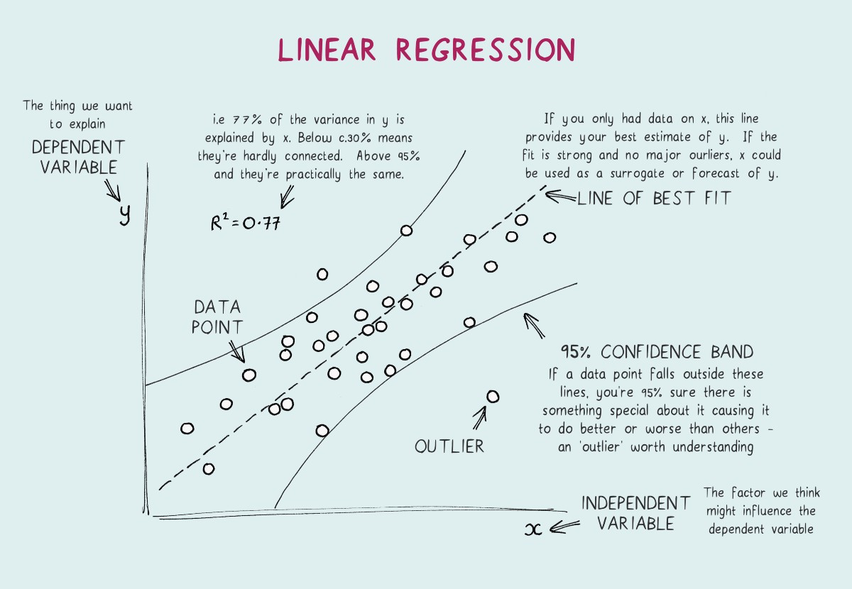
Ho Wei Ling Charmaine
LINEAR REGRESSION
Notes:
Thank you Ben, next i will be presenting on linear regression.

Slide 17
Ho Wei Ling Charmaine
DATA CLEANING
For each dataset, NA values found in each row were replaced by the mean of available values of the row
Extracted only values from 2010 to 2020
Combined the individual datasets to form a CSV file with 14 columns:
Country Name, Year and 12 indicators
Significant year in which the UN’s Millennium Development Goals were reviewed
The most recent and complete data available is up to 2020.
INTRODUCTION
INTRODUCTION
BUSINESS OPPORTUNITY
BUSINESS OPPORTUNITY
PROPOSED APPROACH
PROPOSED APPROACH
ISSUE 2
ISSUE 2
LINEAR REGRESSION
LINEAR REGRESSION
CART MODEL
CART MODEL
RECOMMENDATION
RECOMMENDATION
Notes:
Before we dive into the linear regression model, we first need to perform data cleaning.
For each dataset, NA values found in each row were replaced by the mean of available values of the row. After which, we extracted only values from 2010 to 2020. We chose to start from 2010 as it was a significant year in which the UN’s Millennium Development goals were reviewed. Looking at statistical data after this milestone acts as a review of progress made in global humanitarian efforts. We ended with the year 2020 because the most recent and complete data available is up till 2020. This range also provided sufficient data points to work with.
We then combined the individual datasets to form a CSV file with 14 columns: so we have a column for country name, year and the 12 indicators we have identified previously.

Slide 18
Ho Wei Ling Charmaine
Linear regression is a linear approach for modelling the relationship between independent and dependent variables
WHAT IS LINEAR REGRESSION?
INTRODUCTION
BUSINESS OPPORTUNITY
PROPOSED APPROACH
ISSUE 2
LINEAR REGRESSION
CART MODEL
RECOMMENDATION
Notes:
Moving on to linear regression, what is linear regression? Linear regression is a linear approach for modelling the relationship between independent and dependent variables. We can apply the linear regression model to predict the Infant Mortality Rates based on the indicators identified previously.

Slide 19
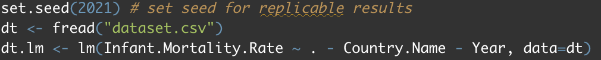
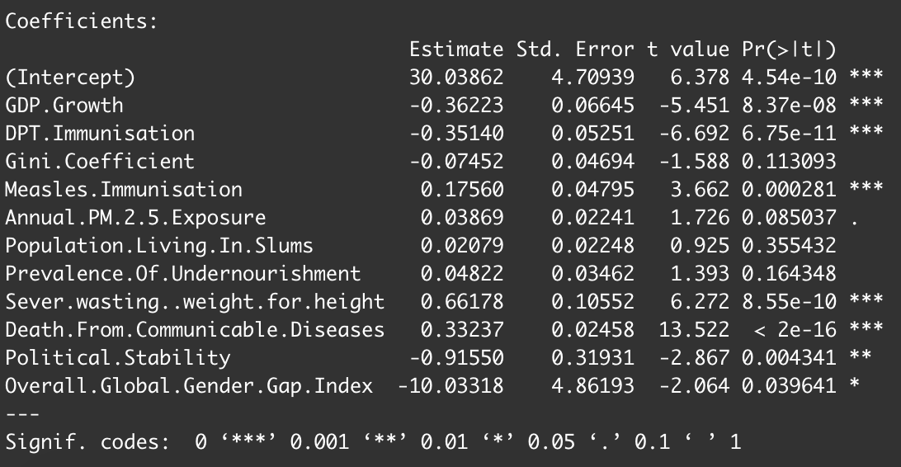
Ho Wei Ling Charmaine
BUILDING THE MODEL
INTRODUCTION
BUSINESS OPPORTUNITY
PROPOSED APPROACH
ISSUE 2
LINEAR REGRESSION
CART MODEL
RECOMMENDATION
Notes:
First, we can build the model, using the lm() function.
After building the model, it is important to look at a summary of the model and identify insignificant variables by examining the p-value for each term. The p-value for each term tests the null hypothesis that the coefficient is equal to zero. A low p-value of less than 0.1 indicates that you can reject the null hypothesis. In other words, a predictor that has a low p-value is likely to be a meaningful addition to the model because changes in the predictor's value are related to changes in the dependent variable which in this case is infant mortality rate.
From the bottom picture, we identify that the following variables are insignificant: Gini Coefficient, Population Living In Slums and Prevalence of Undernourishment. These insignificant variables should thus be removed and a new linear regression model should be built.

Slide 20
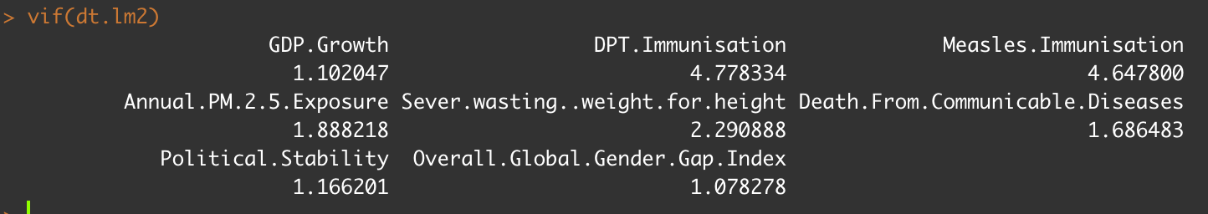
Ho Wei Ling Charmaine
BUILDING THE MODEL
Multicollinearity issues? : Multicollinearity occurs when two or more independent variables are highly correlated with one another.
Benchmark: Multicollinearity is present when VIF>5
→ There are no multicollinearity issues in this linear regression
INTRODUCTION
BUSINESS OPPORTUNITY
PROPOSED APPROACH
ISSUE 2
LINEAR REGRESSION
CART MODEL
RECOMMENDATION
Notes:
Next, it is important to check if there are any multicollinearity issues in the linear regression. Multicollinearity occurs when two or more independent variables are highly correlated with one another. This means that an independent variable can be predicted from another independent variable in a regression model. If there are independent variables which are multicollinear, it is important to remove those variables. By running vif() on the model, we can detect multicollinearity.
Using the benchmark that multicollinearity is present when VIF>5, according to picture, since all indicators have a VIF value of less than 5, there are no multicollinearity issues in this linear regression and thus there is no need to remove any variables from the linear regression.

Slide 21
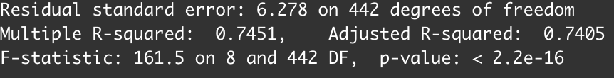
Ho Wei Ling Charmaine
EVALUATION 1
Represent the explanation power of the model
The higher the values, the stronger the model
→ 74% of the data can be explained by the linear regression equation
→ Strong model
INTRODUCTION
BUSINESS OPPORTUNITY
PROPOSED APPROACH
ISSUE 2
LINEAR REGRESSION
CART MODEL
RECOMMENDATION
Notes:
Moving on to an evaluation of the linear regression model:
We can use the summary function to identify the multiple r-squared and adjusted r-squared value. These two values represent the explanation power of the model - the higher the values, the stronger the model.
In this case, about 74% of the data can be explained by the linear regression equation. In addition, given that the multiple R-squared and adjusted R-squared values are relatively high, it is a strong model.

Slide 22

Ho Wei Ling Charmaine
EVALUATION 2
The linear regression model has 3 assumptions:
Linear Association between Y and X variables
Errors has a normal distribution with mean 0
Errors are independent of X and has constant standard deviation
INTRODUCTION
BUSINESS OPPORTUNITY
PROPOSED APPROACH
ISSUE 2
LINEAR REGRESSION
CART MODEL
RECOMMENDATION
Notes:
The linear regression model has 3 assumptions:
Linear Association between Y and X variables
Errors have a normal distribution with mean 0
Errors are independent of X and has constant standard deviation
In order to measure if linear regression model is a good fit for the data, we need to examine the model diagnostic plots and determine if the 3 assumptions are satisfied.

Slide 23
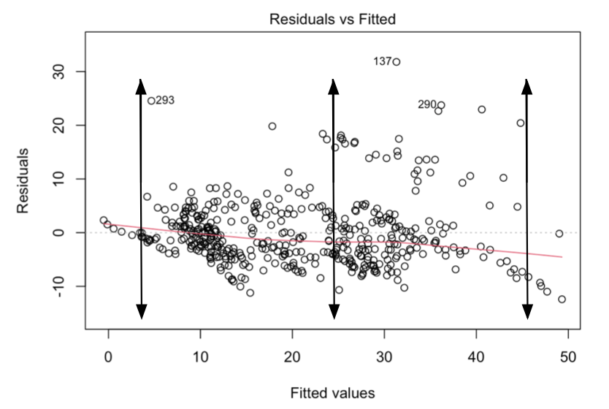
Ho Wei Ling Charmaine
EVALUATION 2
Relatively equal spread out residuals around a horizontal line
→ There are no non-linear relationships
→ Assumption 1 is satisfied
INTRODUCTION
BUSINESS OPPORTUNITY
PROPOSED APPROACH
ISSUE 2
LINEAR REGRESSION
CART MODEL
RECOMMENDATION
Notes:
To measure Assumption 1, we can use a graph that shows the Residuals vs Fitted Values.
Residuals are “leftovers” of the outcome variable after fitting a model to data and they could reveal unexplained patterns in the data. A residual vs. fitted plot can show if residuals have non-linear patterns.
If there are equally spread residuals around a horizontal line without distinct patterns, it is a good indication that there are no non-linear relationships.
In this case, from the graph, we can see that there are relatively equal spread residuals about a horizontal line and thus it is indicative that there are no non-linear relationships. The 1st assumption of a linear association between Y and X variables is thus satisfied.

Slide 24
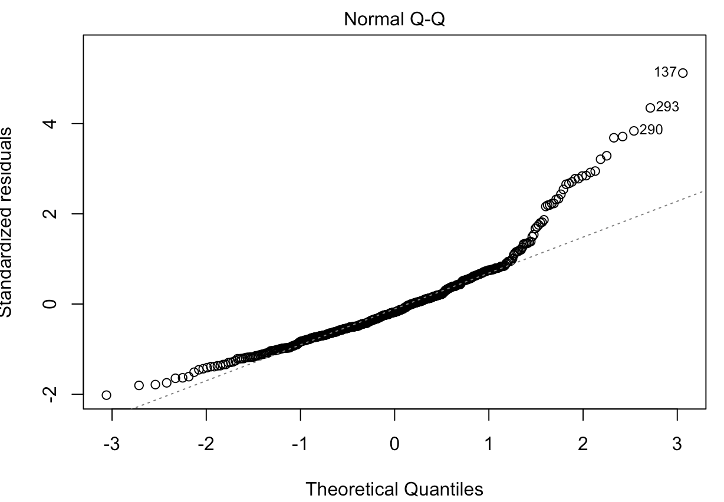
Ho Wei Ling Charmaine
EVALUATION 2
Residuals deviate from the straight line
→ Residuals not not normally distributed
→ Assumption 2 is not satisfied
INTRODUCTION
BUSINESS OPPORTUNITY
PROPOSED APPROACH
ISSUE 2
LINEAR REGRESSION
CART MODEL
RECOMMENDATION
Notes:
Next, we will look at the Normal Q-Q graph. This plot shows if the residuals are normally distributed. If residuals follow a straight line well and do not deviate severely, residuals are normally distributed.
In this case, residuals deviate from the straight line. This suggests that residuals are not normally distributed and the 2nd assumption of errors having a normal distribution with mean 0 is not satisfied.

Slide 25
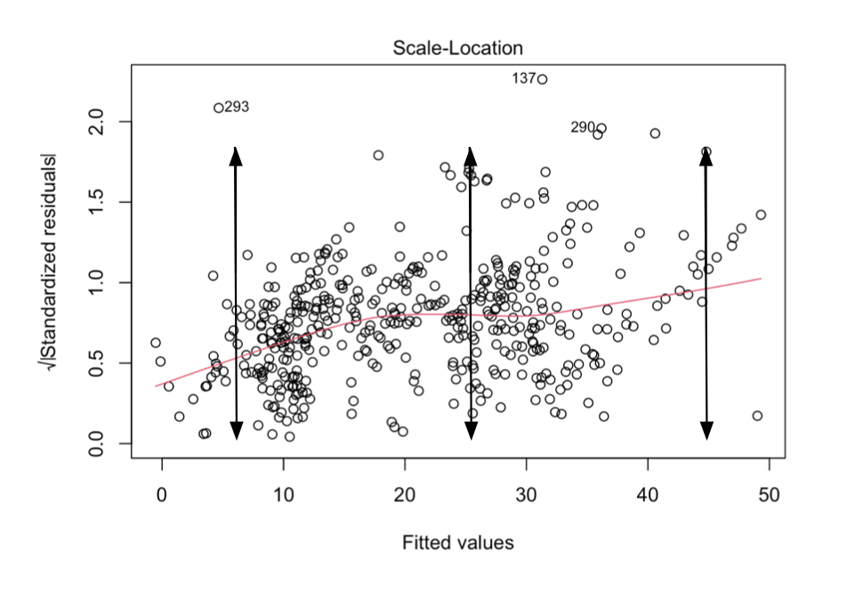
Ho Wei Ling Charmaine
EVALUATION 2
Residuals appear equally and randomly spread
→ Residuals have equal variance
→ Assumption 3 is satisfied
INTRODUCTION
BUSINESS OPPORTUNITY
PROPOSED APPROACH
ISSUE 2
LINEAR REGRESSION
CART MODEL
RECOMMENDATION
Notes:
Finally, let’s take a look at the Scale-Location plot. This plot shows if residuals are spread equally along the ranges of predictors. This is how you can check the assumption of equal variance. A horizontal line with equally and randomly spread points is indicative that residuals have equal variance.
In this case, from the graph, we can see that residuals appear equally and randomly spread. This suggests that residuals have equal variance and the 3rd assumption that errors are independent of X and have constant standard deviation is thus satisfied.

Slide 26
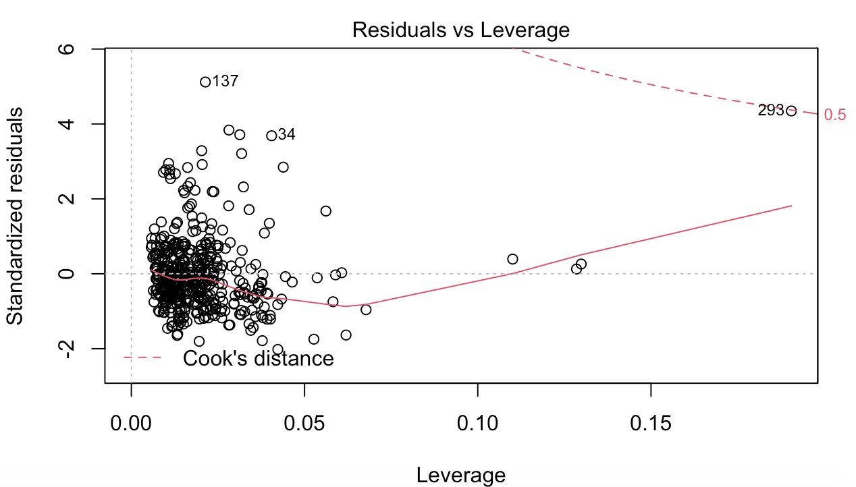
Ho Wei Ling Charmaine
EVALUATION 3
Cook’s distance lines are barely visible
All case are well inside of the Cook’s distance lines
→ No influential case
→ Linear regression is a good fit
INTRODUCTION
BUSINESS OPPORTUNITY
PROPOSED APPROACH
ISSUE 2
LINEAR REGRESSION
CART MODEL
RECOMMENDATION
Notes:
Finally, we will take a look at the Residuals vs Leverage graph. This plot helps identify if there are any influential outliers. Influential outliers are extreme cases against a regression line and can alter the results if we exclude them from analysis. When cases are outside of the Cook’s distance (meaning they have high Cook’s distance scores), the cases are influential.
In this case, the Cook’s distance lines are barely visible for our model, therefore, all the cases are well inside of the Cook’s distance lines. Thus, it suggests that there is no influential case, and linear regression is a good fit for our data.

Slide 27
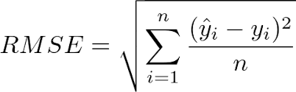
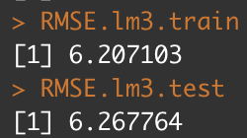
Ho Wei Ling Charmaine
EVALUATION 4
Root Mean Square Error (RMSE): Average difference between the observed known values of the dependent variable and the predicted value
RMSE error both train and test set is low
→ Model is relatively accurate
INTRODUCTION
BUSINESS OPPORTUNITY
PROPOSED APPROACH
ISSUE 2
LINEAR REGRESSION
CART MODEL
RECOMMENDATION
Notes:
We can also use root mean square error or RMSE to determine the model accuracy. RMSE is the average difference between the observed known values of the dependent variable and the predicted value. The lower the RMSE, the better the model accuracy.
In this case, since the root mean square error of both the train and test set is low, the model is relatively accurate.

Slide 28
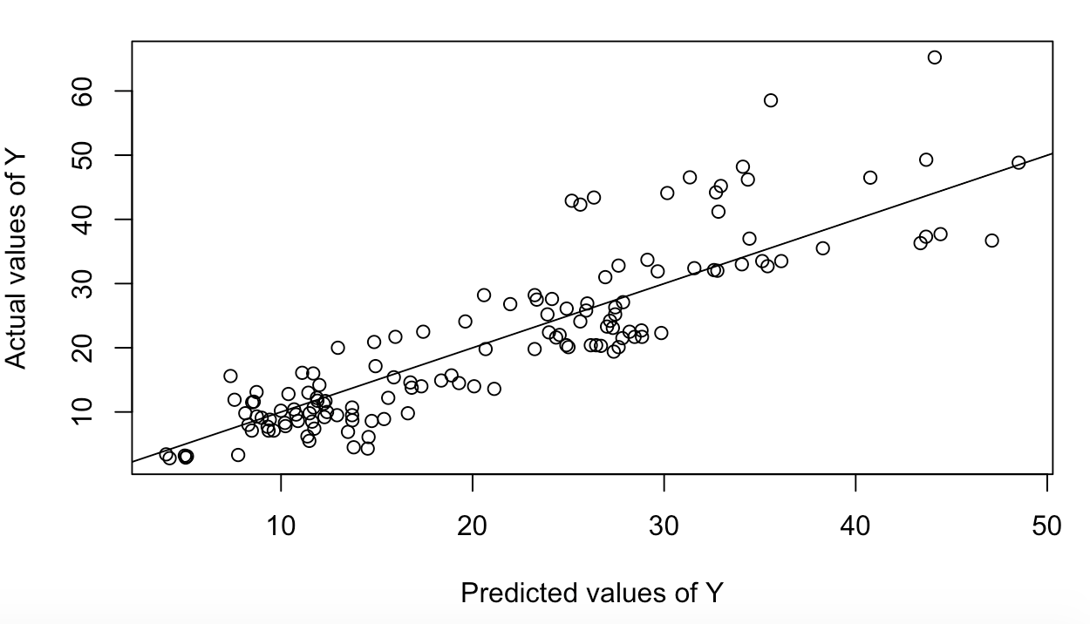
Ho Wei Ling Charmaine
EVALUATION 5
There is a positive linear relationship between actual and predicted infant mortality rates
→ The model is quite accurate
INTRODUCTION
BUSINESS OPPORTUNITY
PROPOSED APPROACH
ISSUE 2
LINEAR REGRESSION
CART MODEL
RECOMMENDATION
Notes:
Finally, we can also plot a graph of actual infant mortality rates against the model predicted infant mortality rates to determine the accuracy of the model.
Given that there is a positive linear relationship between the two, the model is quite accurate.

Slide 29
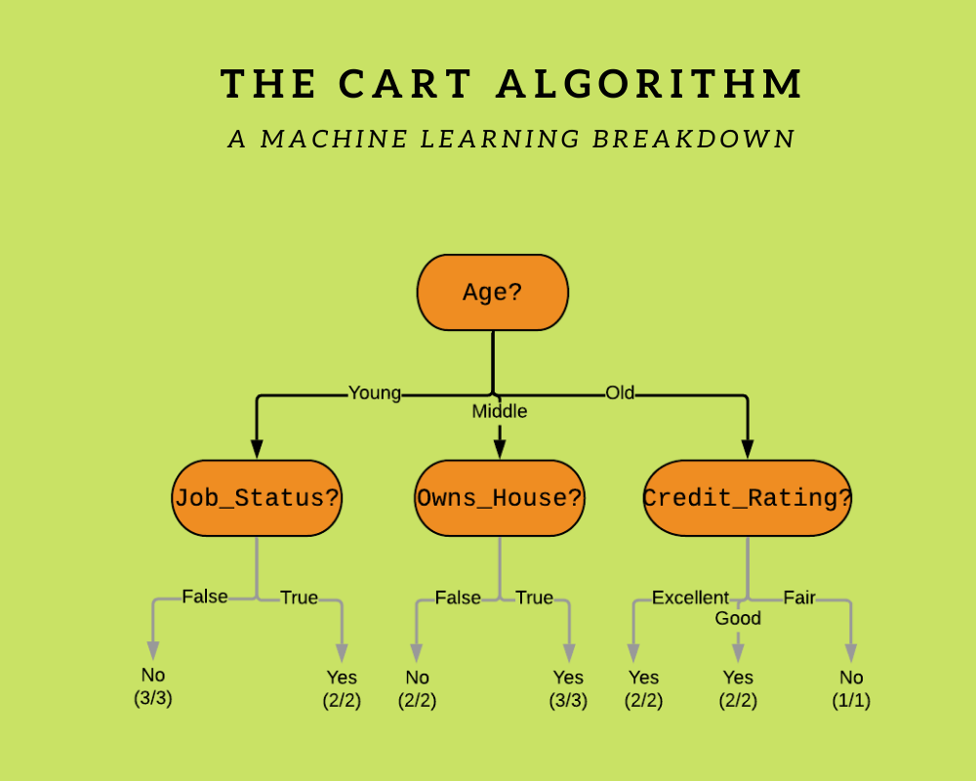
Lim Shi Min
CART MODEL
Notes:
With that I will now hand over my time to Shi Min who will be sharing our application of the CART model.

Slide 30


Lim Shi Min
OVERVIEW
Death from Communicable Diseases
Sever Wasting Weight for Height
DPT Immunisation
Measles Immunisation
GDP Growth
Annual PM 2.5 Exposure
Overall Global Gender Gap Index
Political Stability
Infant Mortality Rate
Dependent Variable (Y)
Independent Variables (X)
INTRODUCTION
BUSINESS OPPORTUNITY
DATA CLEANING
ISSUE 2
LINEAR REGRESSION
CART MODEL
RECOMMENDATION
Notes:
A Classification and Regression Tree (CART) is a predictive algorithm used in machine learning, which explains how a dependent variable can be predicted based on other independent variables. (click)
Our dependent variable Y is Infant Mortality Rate and our CART model aims to predict the Infant Mortality Rate from the significant variables identified earlier from the Linear Regression, (click)
which are Death From Communicable Diseases, Sever Wasting Weight for Height, DPT Immunisation, Measles Immunisation, GDP growth, Annual PM 2.5 Exposure, Overall Global Gender Gap Index, and Political Stability

Slide 31


Lim Shi Min
OVERVIEW
Find patterns in the data
Identify important variables
Make accurate predictions of dependent variable Y (Infant Mortality Rate)
Train Set
Test Set
INTRODUCTION
BUSINESS OPPORTUNITY
DATA CLEANING
ISSUE 2
LINEAR REGRESSION
CART MODEL
RECOMMENDATION
Notes:
So, how CART works is that we need to split our dataset into a train set and a test set, such that we can train the CART model using the train set, where patterns in the data and independent variables that are more important can be identified. Thereafter, we can apply the CART model to the test set to predict the values of the dependent variable Y, and evaluate the accuracy of the model.

Slide 32
Lim Shi Min
DECISION TREE
Classification Tree
Regression Tree
INTRODUCTION
BUSINESS OPPORTUNITY
DATA CLEANING
ISSUE 2
LINEAR REGRESSION
CART MODEL
RECOMMENDATION
Notes:
The CART output is a decision tree, which can be either a classification tree or regression tree. (click)
In our case, our CART output would be a regression tree because our dependent variable Y is continuous. In a regression tree, the model is fit to the dependent variable using each of the independent variables, and the data is split at several points for each independent variable.

Slide 33
Lim Shi Min
COMPLEXITY PARAMETER (CP)
Lower cp value
Higher cp value
INTRODUCTION
BUSINESS OPPORTUNITY
DATA CLEANING
ISSUE 2
LINEAR REGRESSION
CART MODEL
RECOMMENDATION
Notes:
The complexity parameter (cp) imposes a penalty to the tree for having too many splits, hence it is used to control the size of the decision tree and to select the optimal tree size. The lower the cp value, the bigger the tree.

Slide 34
Lim Shi Min
COMPLEXITY PARAMETER (CP)
Shows all the independent variables in the dataset
minsplit = 2
cp = 0
Lower cp value
INTRODUCTION
BUSINESS OPPORTUNITY
DATA CLEANING
ISSUE 2
LINEAR REGRESSION
CART MODEL
RECOMMENDATION
Notes:
We can first create a fully grown tree showing all the independent variables in our dataset by setting the minimum number of splits as 2 and setting the cp as 0.

Slide 35
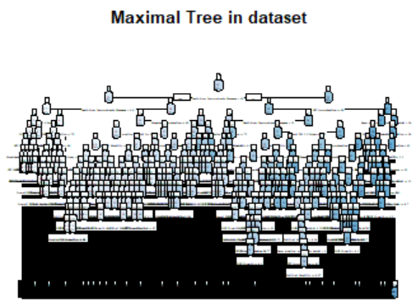
Lim Shi Min
COMPLEXITY PARAMETER (CP)
Overfit the training data
Poor test set performance
INTRODUCTION
BUSINESS OPPORTUNITY
DATA CLEANING
ISSUE 2
LINEAR REGRESSION
CART MODEL
RECOMMENDATION
Notes:
This is the fully grown tree that we got from our dataset. As you can see, the tree is very huge, complex and there are many splits. As such, this fully grown tree will overfit the training data and lead to poor test set performance, hence it is not useful and undesirable.

Slide 36
Lim Shi Min
COMPLEXITY PARAMETER (CP)
Overfitting
Optimal Tree
Too small tree
Prune the tree:
Lower cp value
Optimal cp
Higher cp value
INTRODUCTION
BUSINESS OPPORTUNITY
DATA CLEANING
ISSUE 2
LINEAR REGRESSION
CART MODEL
RECOMMENDATION
Notes:
A strategy to limit this overfitting is to prune the tree in order to get a simpler tree with fewer splits. A too small value of cp leads to overfitting and a too large cp value results in a too small tree. Either case would decrease the predictive performance of the model. (click)
Hence, we need to find the optimal cp value, and thereafter use this value to prune the tree.

Slide 37
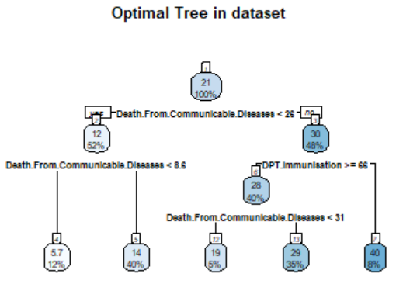
Lim Shi Min
COMPLEXITY PARAMETER (CP)
Fully Grown Tree
Optimal Tree
Pruning
INTRODUCTION
BUSINESS OPPORTUNITY
DATA CLEANING
ISSUE 2
LINEAR REGRESSION
CART MODEL
RECOMMENDATION
Notes:
The plot on the right is the optimal tree that we got after pruning the tree.

Slide 38
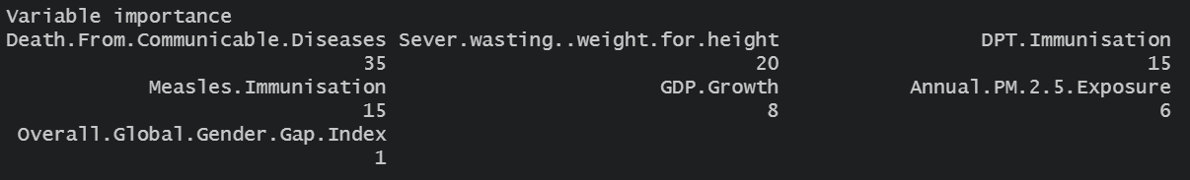
Lim Shi Min
VARIABLE IMPORTANCE
INTRODUCTION
BUSINESS OPPORTUNITY
DATA CLEANING
ISSUE 2
LINEAR REGRESSION
CART MODEL
RECOMMENDATION
Notes:
After getting our optimal regression tree, we can evaluate the relative importance of the independent variables in the regression tree and find out which variables are more important. An important variable is a variable that is used as a primary or surrogate splitter in the regression tree. The variable with higher number means there’s higher importance to the tree. So we can see that Death from Communicable Diseases is the most important factor, taking up 35%, followed by Sever Wasting Weight for Height and DPT Immunisation, which takes up 20% and 15% respectively.

Slide 39
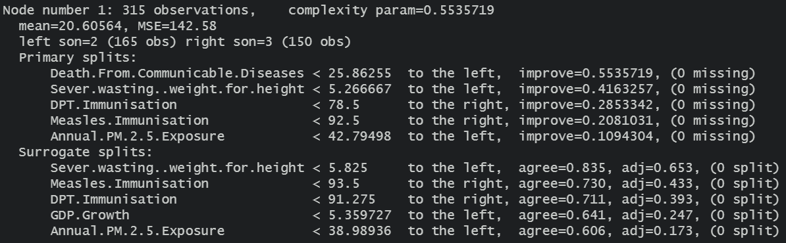
Lim Shi Min
SURROGATES
There are no missing values
Surrogates are not activated
INTRODUCTION
BUSINESS OPPORTUNITY
DATA CLEANING
ISSUE 2
LINEAR REGRESSION
CART MODEL
RECOMMENDATION
Notes:
One key advantage of CART is that it automatically handles missing values through surrogates. When there is a missing value for the current best splitting variable, surrogate splits are used and CART calculates which alternative split resembles the best split. Any observation with a missing value for the best split is then classified using the first (most resembling) surrogate split, or if that value is missing too, the second surrogate split, and so on.
In our case, we did not have any missing values in the primary splits, hence surrogates were not activated.

Slide 40
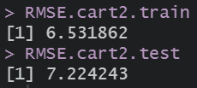
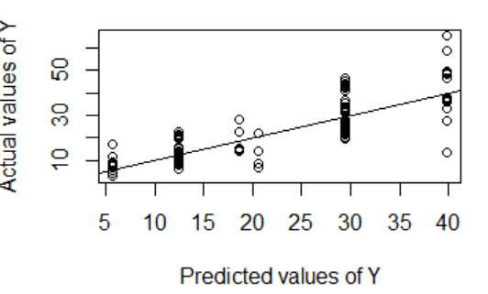
Lim Shi Min
EVALUATION
Plot shows a linear relationship
Model is accurate
INTRODUCTION
BUSINESS OPPORTUNITY
DATA CLEANING
ISSUE 2
LINEAR REGRESSION
CART MODEL
RECOMMENDATION
Notes:
Previously, we have split our dataset into a train set and a test set. Now that we have built our CART model using the train set, we can apply the CART model to the test set to predict the values of the dependent variable, and subsequently evaluate the accuracy of the model. (click)
To evaluate the accuracy of the CART model, we can calculate the Root Mean Square Error (RMSE) of both the train set and test set. The prediction error which is measured by RMSE, is the average difference between the observed known values of the dependent variable and the predicted value by the CART model. The lower the RMSE, the more accurate the model. Since the RMSE of both the train and test set is low, the model is relatively accurate. (click)
Besides calculating the RMSE, we also plotted the observed known values of the dependent variable against the predicted value by the CART model, and the plot shows a positive linear relationship, hence we conclude that the CART model is relatively accurate.

Slide 41
Lim Shi Min
H.I.R.A SCORE
Using our variable importance to calculate our regression scores
INTRODUCTION
BUSINESS OPPORTUNITY
DATA CLEANING
ISSUE 2
LINEAR REGRESSION
CART MODEL
RECOMMENDATION
Notes:
Next, in order to determine the H.I.R.A scores, the variable importance values that we got from the models can be multiplied with their individual values, and then summed up together in a new column.

Slide 42
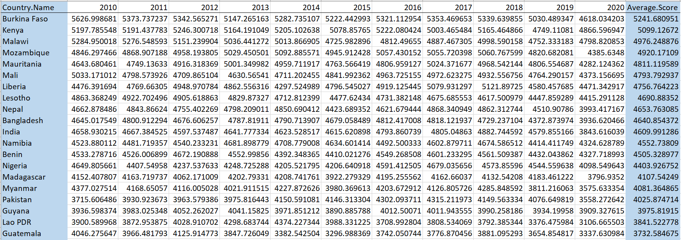
Lim Shi Min
H.I.R.A Scores
INTRODUCTION
BUSINESS OPPORTUNITY
DATA CLEANING
ISSUE 2
LINEAR REGRESSION
CART MODEL
RECOMMENDATION
Notes:
To provide better readability for our target audience, we filter out unnecessary data, compile a timeline of the scores and calculated an average score for each country. This table shows how the output data would look like. We can see that Burkina Faso has the highest H.I.R.A score. This implies that Burkina Faso has the greatest need for medical assistance.

Slide 43

Tan Kiang Hwee Jeremy
RECOMMENDATION

Slide 44

Tan Kiang Hwee Jeremy
EVALUATION
Will add value to EIU’s products and services
Traditional
Surveys
In-house EIU expert ratings
Machine Learning
Panel expert inputs
Faster
Less human effort
More accurate predictions at scale
Less error prone
Effective
Produce valuable insights
INTRODUCTION
BUSINESS OPPORTUNITY
DATA CLEANING
ISSUE 2
LINEAR REGRESSION
CART MODEL
RECOMMENDATION
Notes:
Currently, the EIU uses several forecasting methodologies such as surveys, inputs from experts, and in-house EIU expert ratings. While these are certainly effective and they produce valuable insights, the use of machine learning can definitely help to add value to their products and services.
Firstly, using machine learning is faster, automatic and requires less human effort. In addition, they also tend to be more accurate at making predictions, especially in areas such as pattern recognition, where it has an edge over humans, as we are prone to make errors. Machine learning has the ability to identify patterns and make accurate predictions at a scale and speed that humans are unable to. It is therefore in the EIU’s interest to start incorporating and embracing machine learning models into their research and forecasting process.

Slide 45


Tan Kiang Hwee Jeremy
EVALUATION
Opinions and qualitative insights from experts
More accurate statistical data produced using machine learning
INTRODUCTION
BUSINESS OPPORTUNITY
DATA CLEANING
ISSUE 2
LINEAR REGRESSION
CART MODEL
RECOMMENDATION
Notes:
This is not to say that our model and our application of machine learning is perfect, but we believe that it will add much value to the EIU’s research processes. The opinions and qualitative insights from experts are still very much needed, but with machine learning, these can now be supported with statistical data that is produced in a quicker and more accurate scale.

Slide 46


Tan Kiang Hwee Jeremy
LIMITATIONS
Limited data available
2010-2020 data only
Must have data on all the predictor used in the models
Not very inclusive for all countries
Publicly available data
Has many researchers worldwide and extensive resources to conduct large scale research
Limitations can be overcome easily
INTRODUCTION
BUSINESS OPPORTUNITY
DATA CLEANING
ISSUE 2
LINEAR REGRESSION
CART MODEL
RECOMMENDATION
Notes:
However, one of the limitations that we faced in the process of completing this project was the limited amount of data. We only used data from 2010 to 2020 in our predictive models. Although it was sufficient for the objectives of such a project, it goes without saying that the model would have been much more accurate if trained with more data.
A limitation of the model itself is that it is only a truly accurate predictor when it works with countries that have data collected for all the indicators we used for our model. As a result, this score may not be very inclusive for all countries, since there are definitely many countries that have some lack of data collection for the indicators. We could only work with publicly available data that we could find online.
In contrast, the EIU has many researchers worldwide and extensive resources that allow them to conduct large scale research, and so this limitation could be easily overcome as they are able to do the necessary research and obtain the data for these indicators for all the 200 plus countries they have produced country reports for.

Slide 47





Tan Kiang Hwee Jeremy
RECOMMENDATIONS
Without Machine Learning
With Machine Learning
INTRODUCTION
BUSINESS OPPORTUNITY
DATA CLEANING
ISSUE 2
LINEAR REGRESSION
CART MODEL
RECOMMENDATION

Slide 48







Tan Kiang Hwee Jeremy
RECOMMENDATIONS
Our product would be able to solve the needs that these organisations have and allow them to make well-informed decisions
INTRODUCTION
BUSINESS OPPORTUNITY
DATA CLEANING
ISSUE 2
LINEAR REGRESSION
CART MODEL
RECOMMENDATION

Slide 49

Tan Kiang Hwee Jeremy
CONCLUSION
Stiff competition
Machine Learning
Opinions and qualitative insights from experts
More accurate statistical data produced using machine learning
INTRODUCTION
BUSINESS OPPORTUNITY
DATA CLEANING
ISSUE 2
LINEAR REGRESSION
CART MODEL
RECOMMENDATION
Notes:
In conclusion, EIU faces stiff competition in the forecasting market, and constantly needs to improve their game to stay afloat in this cutthroat environment. There is significant value in the EIU adopting machine learning for their strategies, and hence we believe that the EIU should definitely consider adopting machine learning models. Statistical data with higher accuracy coupled with opinions and qualitative insights from experts would give EIU the competitive edge.

Slide 50

Tan Kiang Hwee Jeremy
CONCLUSION
Serves to act as a pilot study for EIU to evaluate machine learning
Allows readers to interpret results and implications
Evaluates the feasibility of some crucial components
Adoption of machine learning methodology works and is relatively accurate
Current publicly available dataset is insufficient
Proof of Concept (POC)
INTRODUCTION
BUSINESS OPPORTUNITY
DATA CLEANING
ISSUE 2
LINEAR REGRESSION
CART MODEL
RECOMMENDATION
Notes:
Finally, the team definitely recommends the EIU to adopt this machine learning proof of concept (POC). Pilot studies are small-scale, preliminary studies which aim to investigate whether crucial components of a main study – usually a randomized controlled trial (RCT) – will be feasible. This POC serves to act as a pilot study for EIU to evaluate machine learning as our POC allows readers to interpret the results and implications correctly, and evaluate the feasibility of some crucial components, such as the collection of data. Based on our POC, it can be seen that the proposed machine learning methodology works and is relatively accurate. However, we have evaluated that the current publicly available dataset is insufficient. There is a need to gather more data and include more countries into our analysis.

Slide 51




Tan Kiang Hwee Jeremy
CONCLUSION
Proof of Concept (POC)
INTRODUCTION
BUSINESS OPPORTUNITY
DATA CLEANING
ISSUE 2
LINEAR REGRESSION
CART MODEL
RECOMMENDATION
Notes:
With EIU’s extensive capabilities, EIU could easily provide the data points needed for the model to be more accurate and effective. With its many researchers worldwide and extensive resources, EIU can collect all the data required to evaluate and look more deeply into a country’s economy to find new relationships in the healthcare administration that have not been researched on before.

Slide 52

Tan Kiang Hwee Jeremy
Notes:
With EIU’s extensive capabilities, EIU could easily provide the data points needed for the model to be more accurate and effective. With its many researchers worldwide and extensive resources, EIU can collect all the data required to evaluate and look more deeply into a country’s economy to find new relationships in the healthcare administration that have not been researched on before.

